Slide 1

Emotion Identification Through Facial Recognition
Project 2

Slide 2
Executive Summary (Sterling)
Add a few lines here
Notes:
An executive summary of the project and project goals. (5 points)
Explain how this project relates to fintech and machine learning.

Slide 3
Data Preparation (Mike)
Dataset from Kaggle contains different expressions of the human face (happy, sad, angry, neutral, surprise, fear, disgust)
The training set contains 28,273 images and the test set contains 7,067 images of facial expressions
Image generation: 150 x 150 x 3,
Rescale to 1.0/255 to reduce resources (RGB is 0-255)
Notes:
https://www.kaggle.com/code/yassineghouzam/introduction-to-cnn-keras-0-997-top-6
https://www.kaggle.com/code/nguyendaitruongthanh/facial-emotion-detection-with-cnn

Slide 4
Optimizers
Animation of 5 gradient descent methods :
gradient descent (cyan), momentum (magenta),
AdaGrad (white),
RMSProp (green),
Adam (blue)
Left well is the global minimum;
right well is a local minimum.
Notes:
Gradient Descent Visualization
RMSProp
The problem of AdaGrad, however, is that it is incredibly slow. This is because the sum of gradient squared only grows and never shrinks. RMSProp (for Root Mean Square Propagation) fixes this issue by adding a decay factor.
Adam
Last but not least, Adam (short for Adaptive Moment Estimation) takes the best of both worlds of Momentum and RMSProp.
Resource
https://towardsdatascience.com/a-visual-explanation-of-gradient-descent-methods-momentum-adagrad-rmsprop-adam-f898b102325c

Slide 5
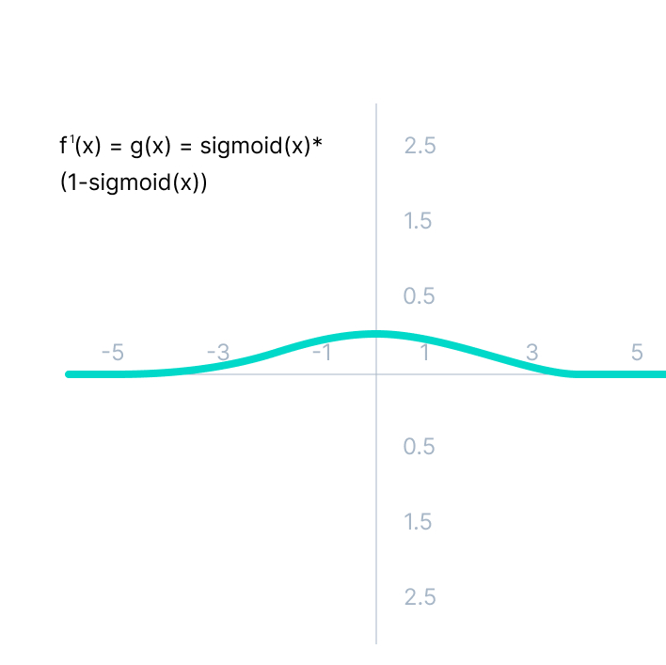
Vanishing Gradient Problem
Sigmoid Activation Function
Values beyond 3 & -3 are flatter so their function will have smaller gradients.
Eventually reach zero.
Network ceases to learn.
(Logistic function is not symmetric at zero so the output will all be the same sign = unstable NN = more difficult training)
Notes:
As we can see from the above Figure, the gradient values are only significant for range -3 to 3, and the graph gets much flatter in other regions.
It implies that for values greater than 3 or less than -3, the function will have very small gradients. As the gradient value approaches zero, the network ceases to learn and suffers from the Vanishing gradient problem.
The output of the logistic function is not symmetric around zero. So the output of all the neurons will be of the same sign. This makes the training of the neural network more difficult and unstable.

Slide 6
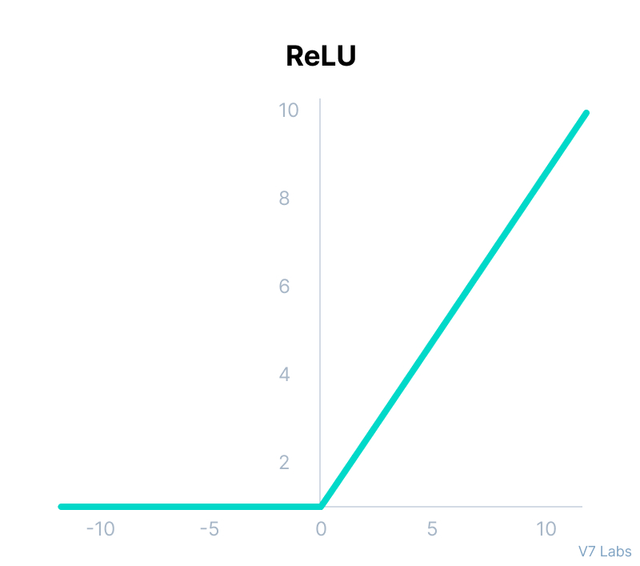
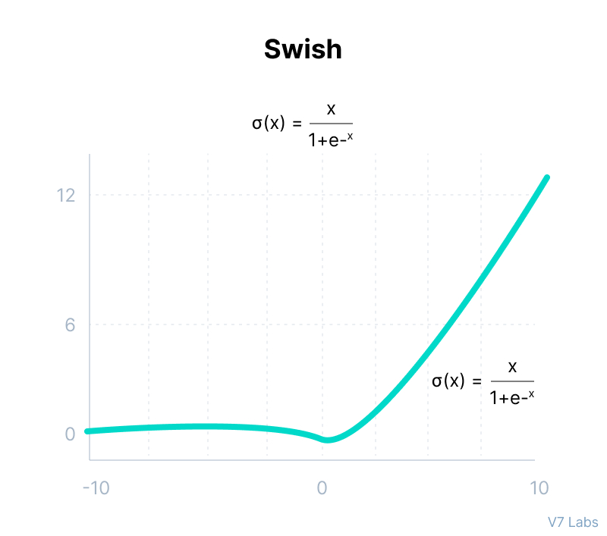
Rectified Linear Unit & Swish Activation Functions are Computationally Efficient
Neurons deactivated if output less than zero.
Accelerates the convergence towards the global min.
Smooth function at zero
Small negative values are kept which can be relevant.
Notes:
Although it gives an impression of a linear function, ReLU has a derivative function and allows for backpropagation while simultaneously making it computationally efficient.
The main catch here is that the ReLU function does not activate all the neurons at the same time.
The neurons will only be deactivated if the output of the linear transformation is less than 0.
The advantages of using ReLU as an activation function are as follows:
Since only a certain number of neurons are activated, the ReLU function is far more computationally efficient when compared to the sigmoid and tanh functions.
ReLU accelerates the convergence of gradient descent towards the global minimum of the loss function due to its linear, non-saturating property.
The limitations faced by this function are:
The Dying ReLU problem, which I explained below.
---------------------------------------
Swish
It is a self-gated activation function developed by researchers at Google.
Swish consistently matches or outperforms ReLU activation function on deep networks applied to various challenging domains such as image classification, machine translation etc.

Slide 7
Model Training Process (Mike)
# model = RMS Optimizer, Relu Activation
# model_adam = ADAM optimizer, Relu Activation
# model_swish = RMS Optimizer, Swish Activation
# model_adam_swish = ADAM Optimizer, Swish Activation
# model_CNN = Convolutional Neural Network

Slide 8
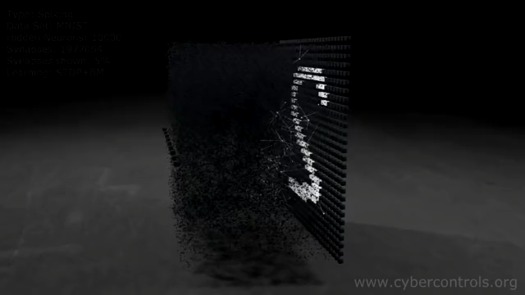
Selected Model (Sterling) (CNN)

Slide 9
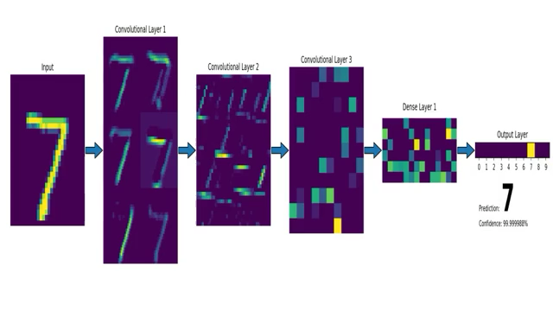
CNN: Convolutional Neural Network

Slide 10
Approach to achieve project Goals

Slide 11
Results & Conclusions

Slide 12
Next Steps (Leo)

